Slide 1
WORKOUT BUDDY
By Rafe Gerson, Kavi Nelakonda, Jay Paek
Notes:
(Team Introductions): And here’s what we’ve accomplished so far.

Slide 2
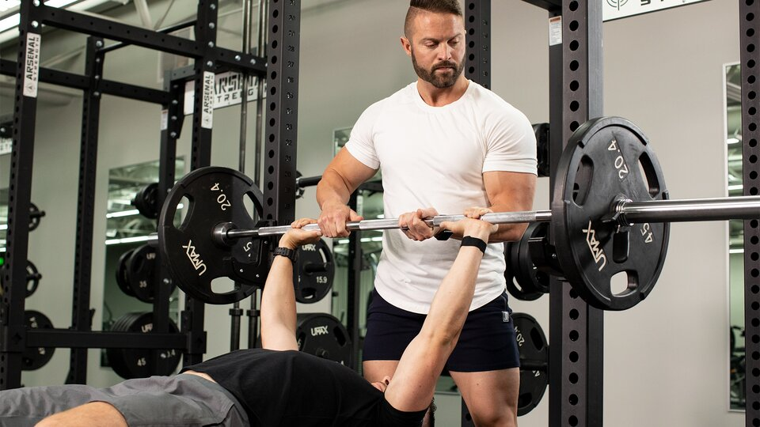
Problem
https://www.bodybuilding.com/fun/spotting-101-how-to-spot-the-bench-squat-and-dumbbell-press.html
https://fitnessvolt.com/how-to-be-good-spotter/
Notes:
Rafe: Just to refresh, the problem we are trying to solve is the tracking of repetitions when a lifter is listening to music or focusing on the exercises at hand. Additionally, monitoring the quality of repetitions can be difficult without an external source (i.e., a mirror or spotter).

Slide 3
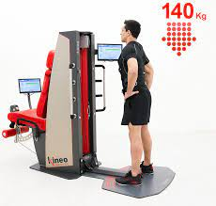
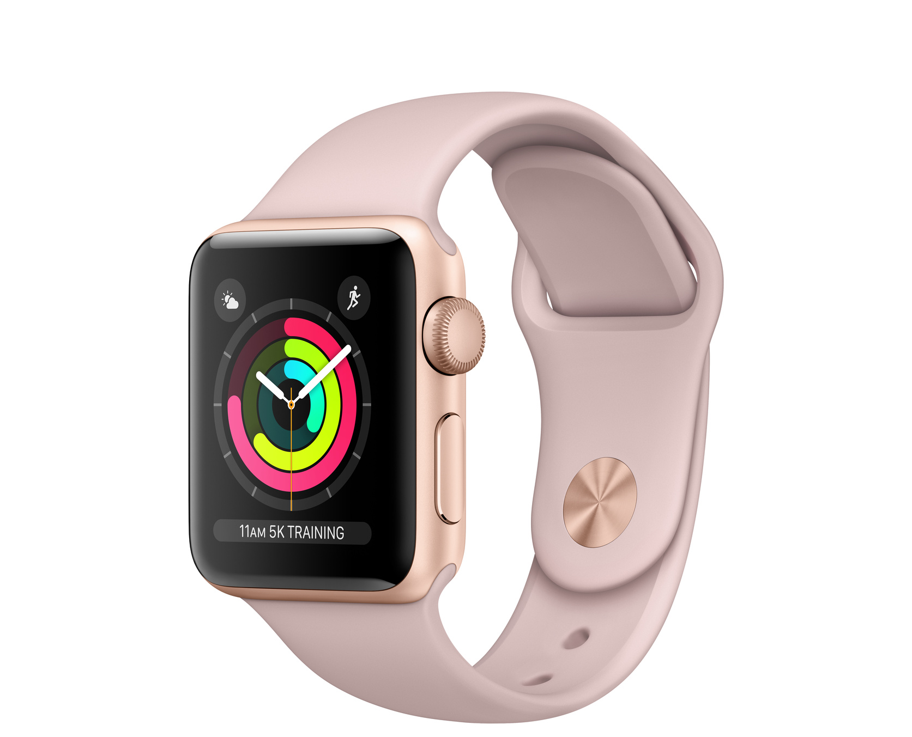
Problem (cont.)
Such tools exists.
However these products are often:
Expensive
Bulky
Kineosystem
https://www.kineosystem.com/sport/
Smart Watch
https://www.apple.com/shop/product/FQKW2LL/A/Refurbished-Apple-Watch-Series-3-GPS-38mm-Gold-Aluminum-Case-with-Pink-Sand-Sport-Band
https://fitnessvolt.com/how-to-be-good-spotter/
Notes:
Rafe: Highlight available solutions

Slide 4
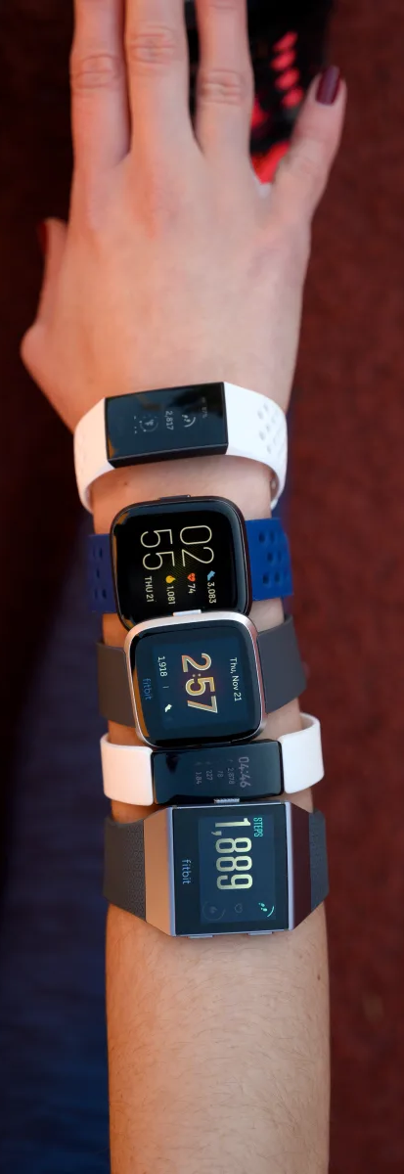
Idea/Hypothesis
Device that straps around the wrist or workout apparatus
Simple/cheap/wearable
Track repetitions + their quality.
log data + provide analysis.
https://www.reviewed.com/health/best-right-now/the-best-fitbits
Notes:
Kavi

Slide 5
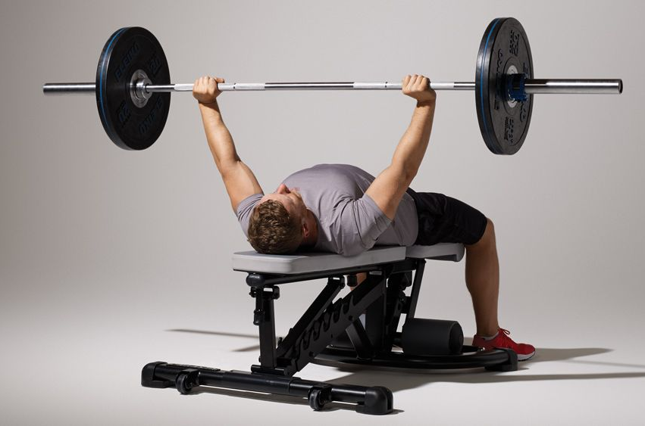
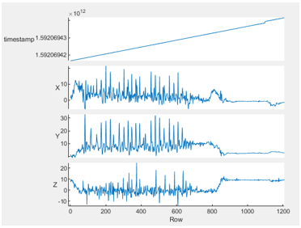
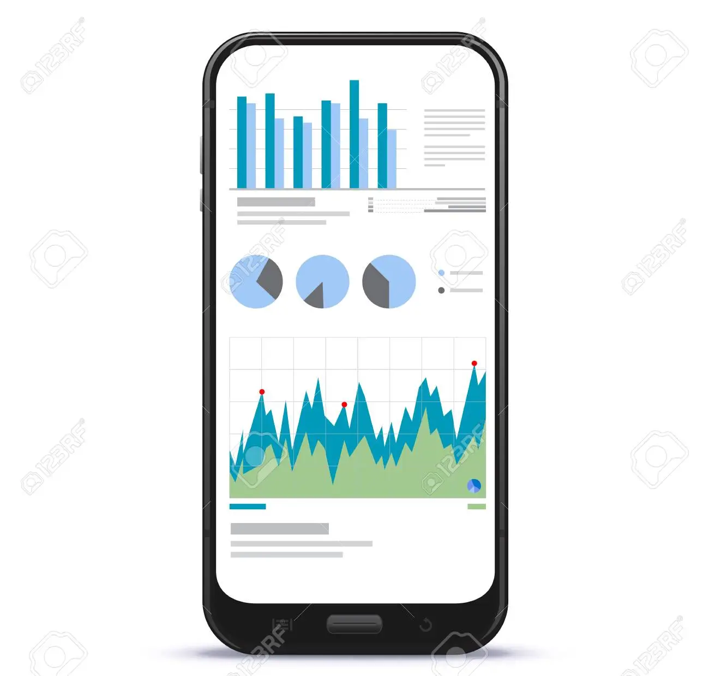
Workout
Motion Detection
Optimize
Workout Routine
https://www.coachmag.co.uk/exercises/chest-exercises/186/bench-press-technique-tips
Analyze Data
Gather Accelerometer Data
Bluetooth
https://medium.com/three-axis-sensor-based-data/accelerometer-an-accelerometer-sensor-is-a-device-utilized-for-measuring-acceleration-which-can-e60e4216b615
https://www.123rf.com/photo_93285892_mobile-phone-screen-with-financial-charts-and-graphs.html
Notes:
Jay: Our wearable device will make it easier for people to count their reps during workouts without the need of trainers or expensive equipment. An accelerometer will be used to count reps since acceleration and velocity is continuous in real life. The LCD display will allow users to track the number and timing of repetitions for certain exercises.

Slide 6
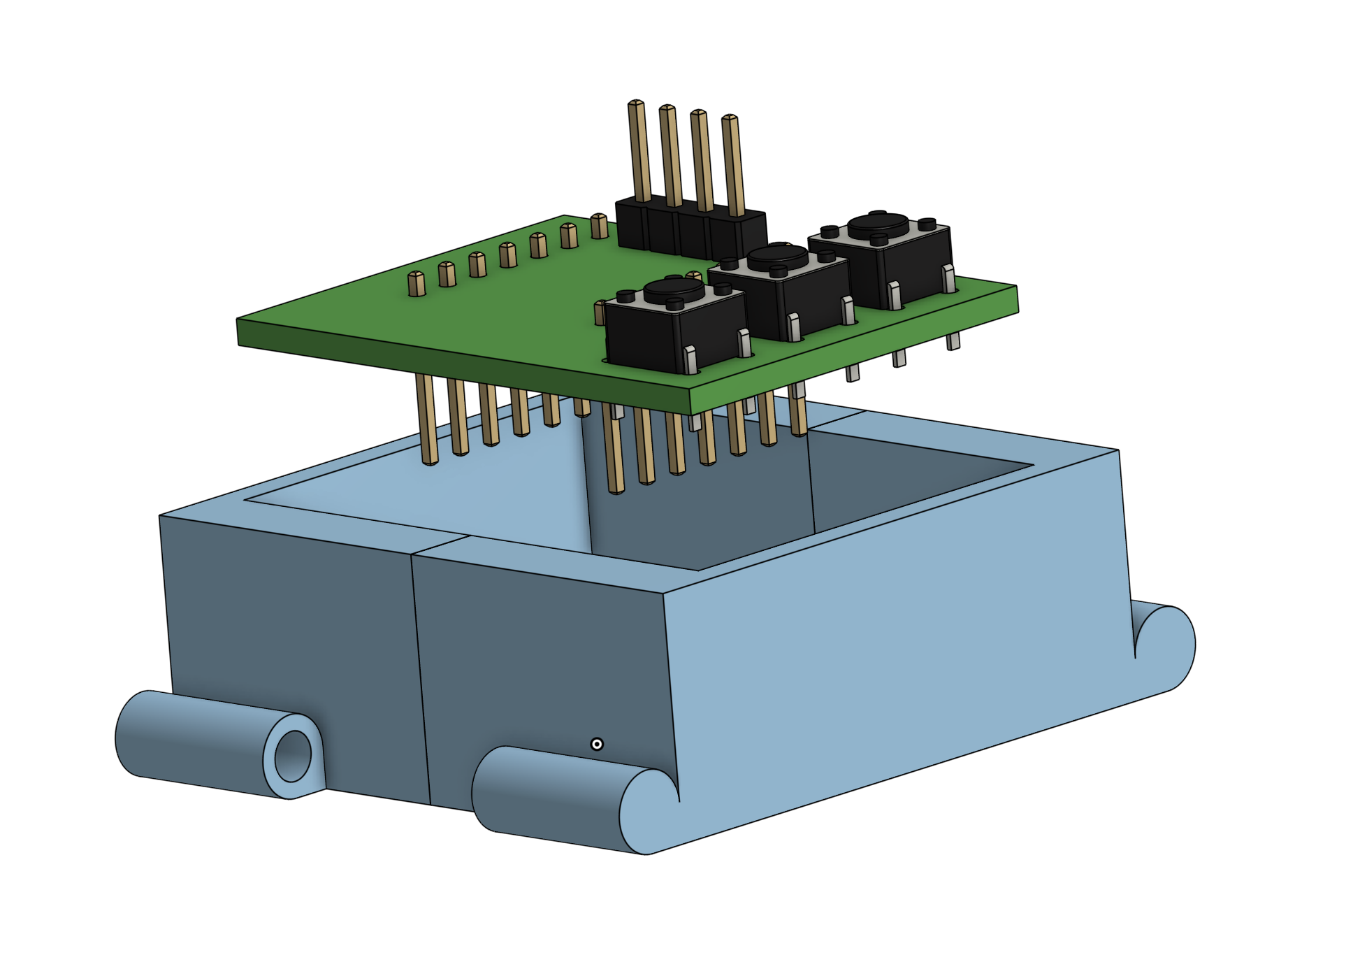

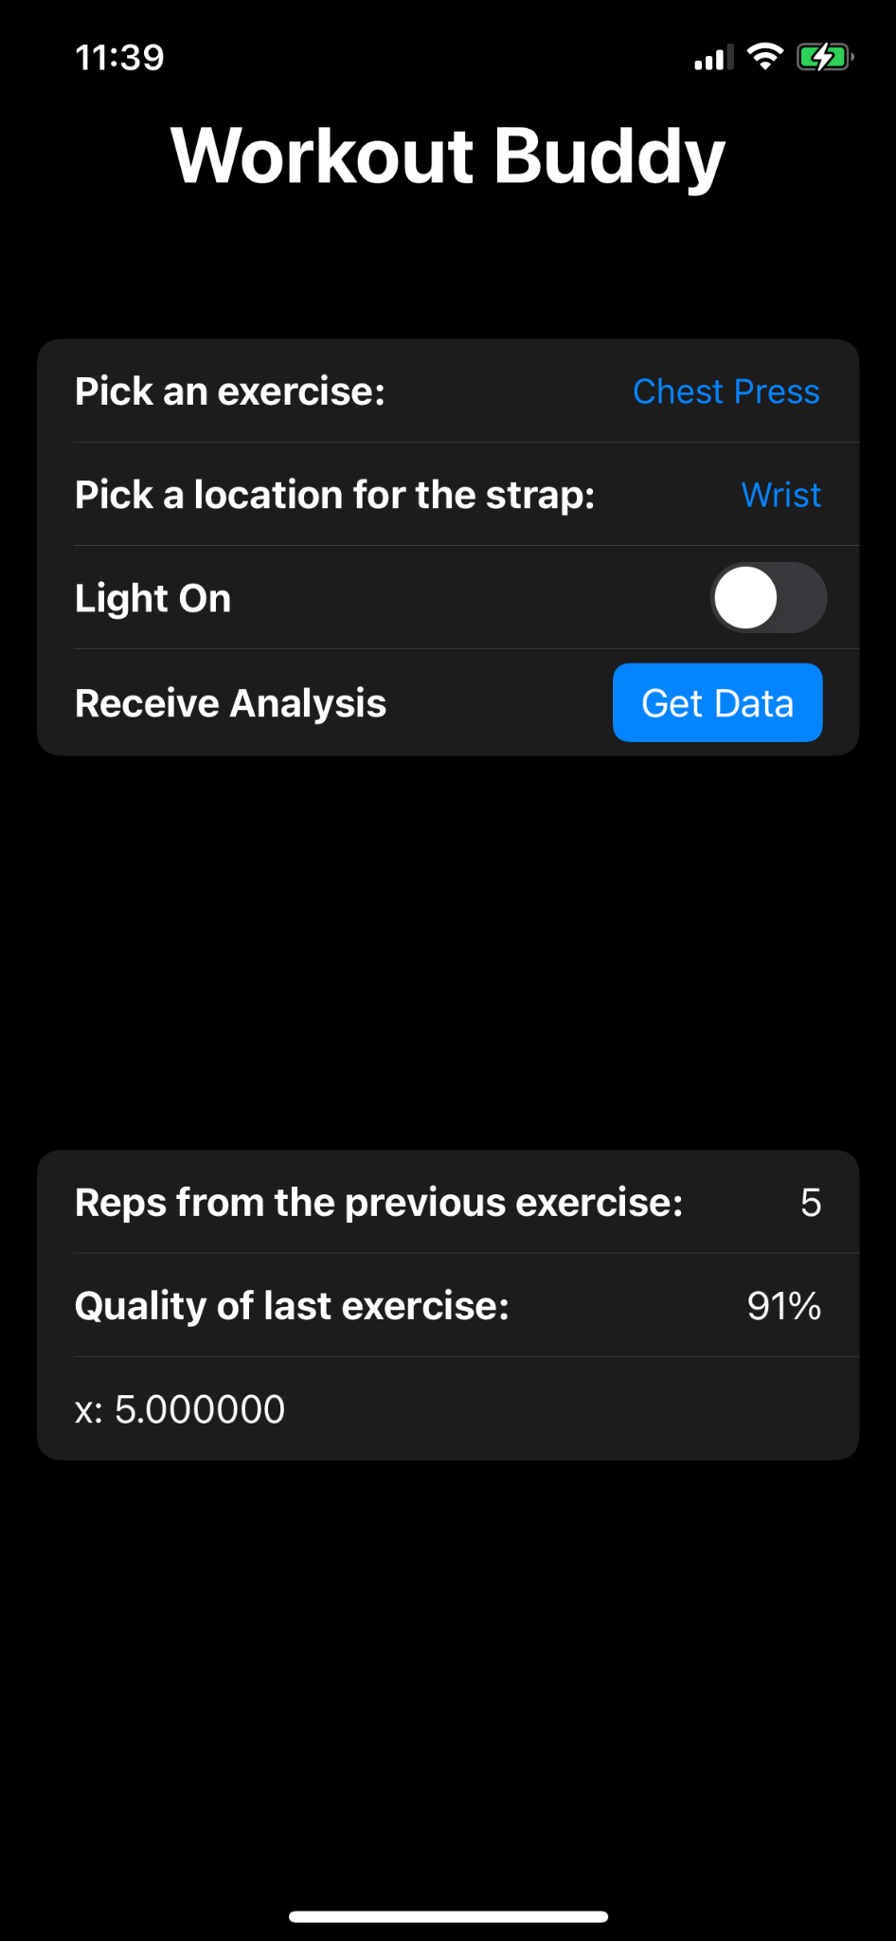
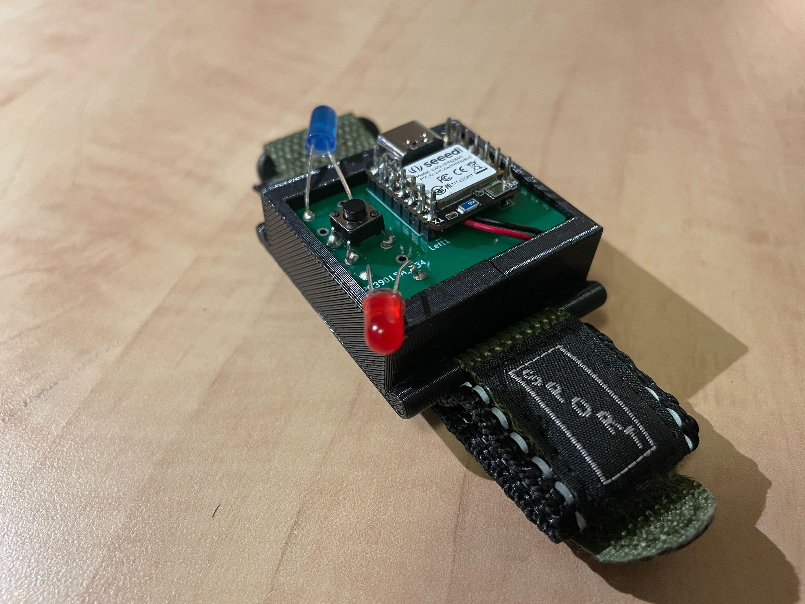
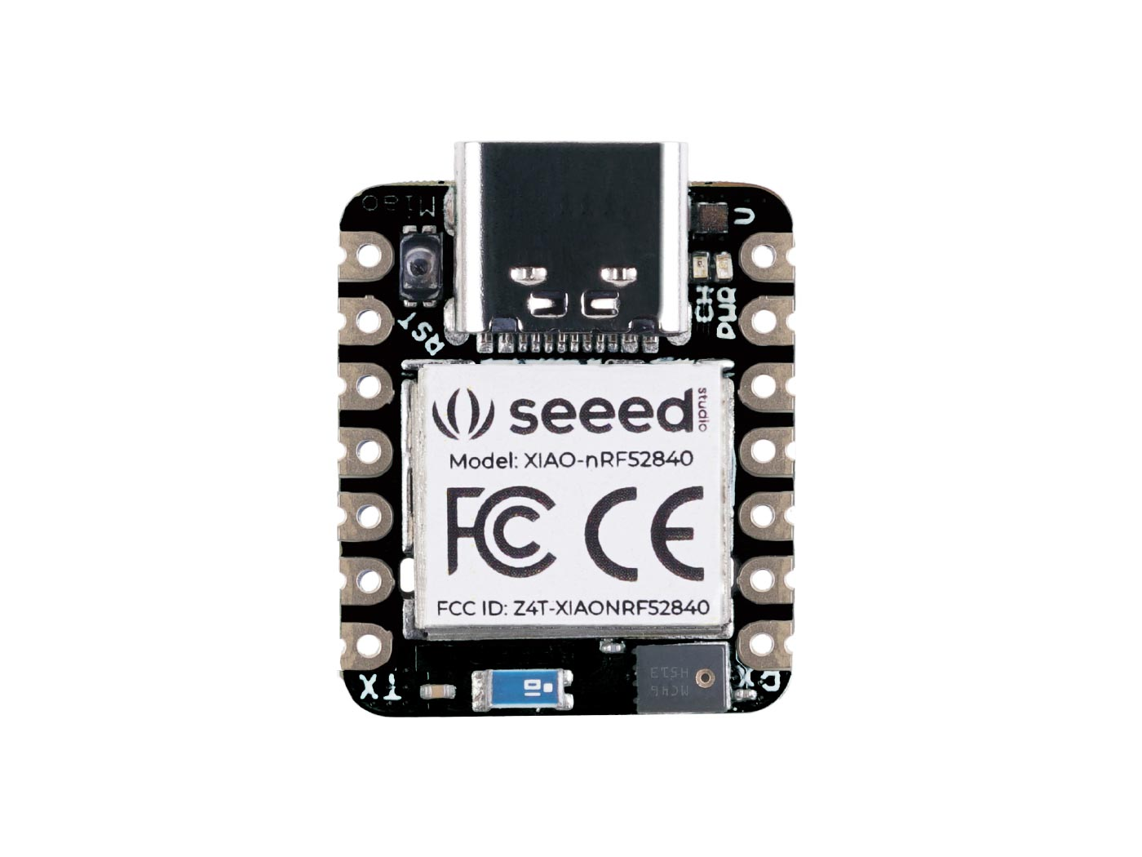
Milestones
Finish Chassis and PCB (Oct 28)
Finish programming the microcontroller (Nov 15)
Configure bluetooth (Nov 17)
Complete application to log data (Nov 24)
https://wiki.seeedstudio.com/XIAO_BLE/
Notes:
Jay

Slide 7

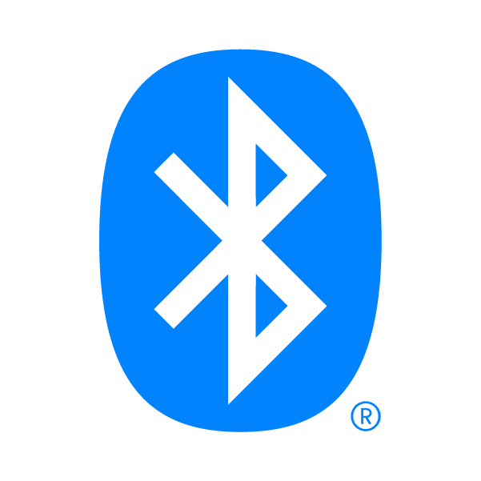
Workshop
Expectation: Some Swift knowledge
Configuring bluetooth w/ Swift
Communicating with external device through bluetooth
https://developer.apple.com/swift/images/swift-og.png
https://www.bluetooth.com/
Notes:
Kavi

Slide 8

Citations/Resources
Seeed nRF52480 Sense:
https://how2electronics.com/send-receive-data-to-mobile-app-with-xiao-ble-nrf52840-sense/
https://how2electronics.com/using-imu-microphone-on-xiao-ble-nrf52840-sense/
https://wiki.seeedstudio.com/XIAO-BLE-Sense-Bluetooth-Usage/
(Board)https://raw.githubusercontent.com/Seeed-Studio/Seeed_Platform/master/package_seeeduino_boards_index.json
Creating the App:
https://developer.apple.com/documentation/swiftui
https://www.hackingwithswift.com/
https://github.com/AdinAck/EnVision-Tutorial-Lamp/wiki/App
https://developer.apple.com/documentation/swift
https://www.youtube.com/watch?v=crOqqagCQRg
https://canvas.ucsd.edu/courses/41661/files/7967119?module_item_id=1546512
Notes:
Rafe: Seeedduino
Kavi: Creating the App

Slide 9
Questions?

